Slide 1


Innovating psychological therapy
PAX
A new way connect therapists and patients.

Slide 2

About Us
Collaboratively help patients with psychological disorders
Provide more accessible, comfortable, and affordable therapy.
Team of college students with different backgrounds and skills looking to make an impact

Slide 3



The Problem
Social Stigma
Cost
Accessibility
Social stigma associated with psychological therapy.
Specific psychological therapies can be expensive.
Patients cannot find ideal therapists
PAX

Slide 4
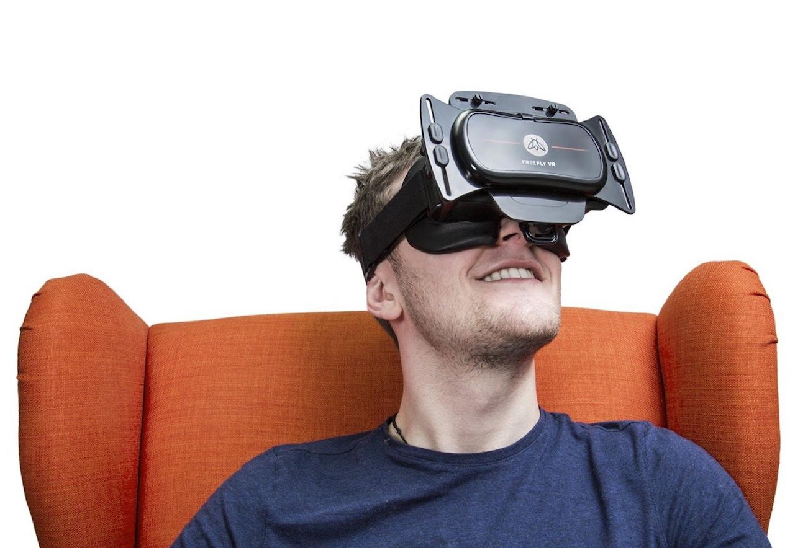


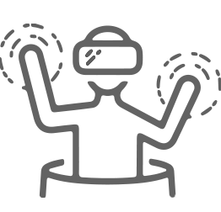
Solution
Connective
Immersive
Versatile
Connect therapists across the globe
Exclusive and Immersive treatments
Works on any headset and phone
PAX

Slide 5


Business Model
A new way connect therapists and patients.
PAX

Slide 6



Business Model
There is an opportunity for success
Modular
Safe
Accessible
Multiple patented models that provide endless experiences
Virtual simulation to prevent physical exposure therapy
Patients granted fast and convenient access from remote locations
PAX

Slide 7
Market Opportunity
Potential Clients
Therapy Centres
19.2M
200K
3
Few Competitors
PAX

Slide 8
Competition
PAX
Verapy
Affordable, Versatile
Multi-platform solution
Broad Connectivity
Expensive, Limited
Single-platform
Limited accessibility
PAX

Slide 9



Competition Option 2
Convenience
Expensive
Affordable
Inconvenient
PAX

Slide 10
Growth Strategy
How will we scale in the future
Phase 1 Q1 Q2, 2019
Phase 2 Q2 Q3, 2019
Phase 3 2020
Partner with researchers to study mental disorders efficiently
Refine therapy modules
Collaborate with therapy groups
Promote product to therapy clinics
Use metric data to iteratively refine modules
Associate with insurance companies
Innovate and integrate with other wearable technology
PAX

Slide 11
Timeline
Our two-year action plan
Push to Therapy Clinics
Develop Prototype
Design V2
Feb, 2019
Oct, 2019
Nov, 2020
01
02
03
04
05
06
07
08
09
10
11
12
01
02
03
04
05
06
07
08
09
10
11
12
2019
2020
Collaborate with Therapy Groups
Associate with insurance companies
Innovate wearable technology
Jun, 2019
Jul, 2020
Jan, 2019

Slide 12

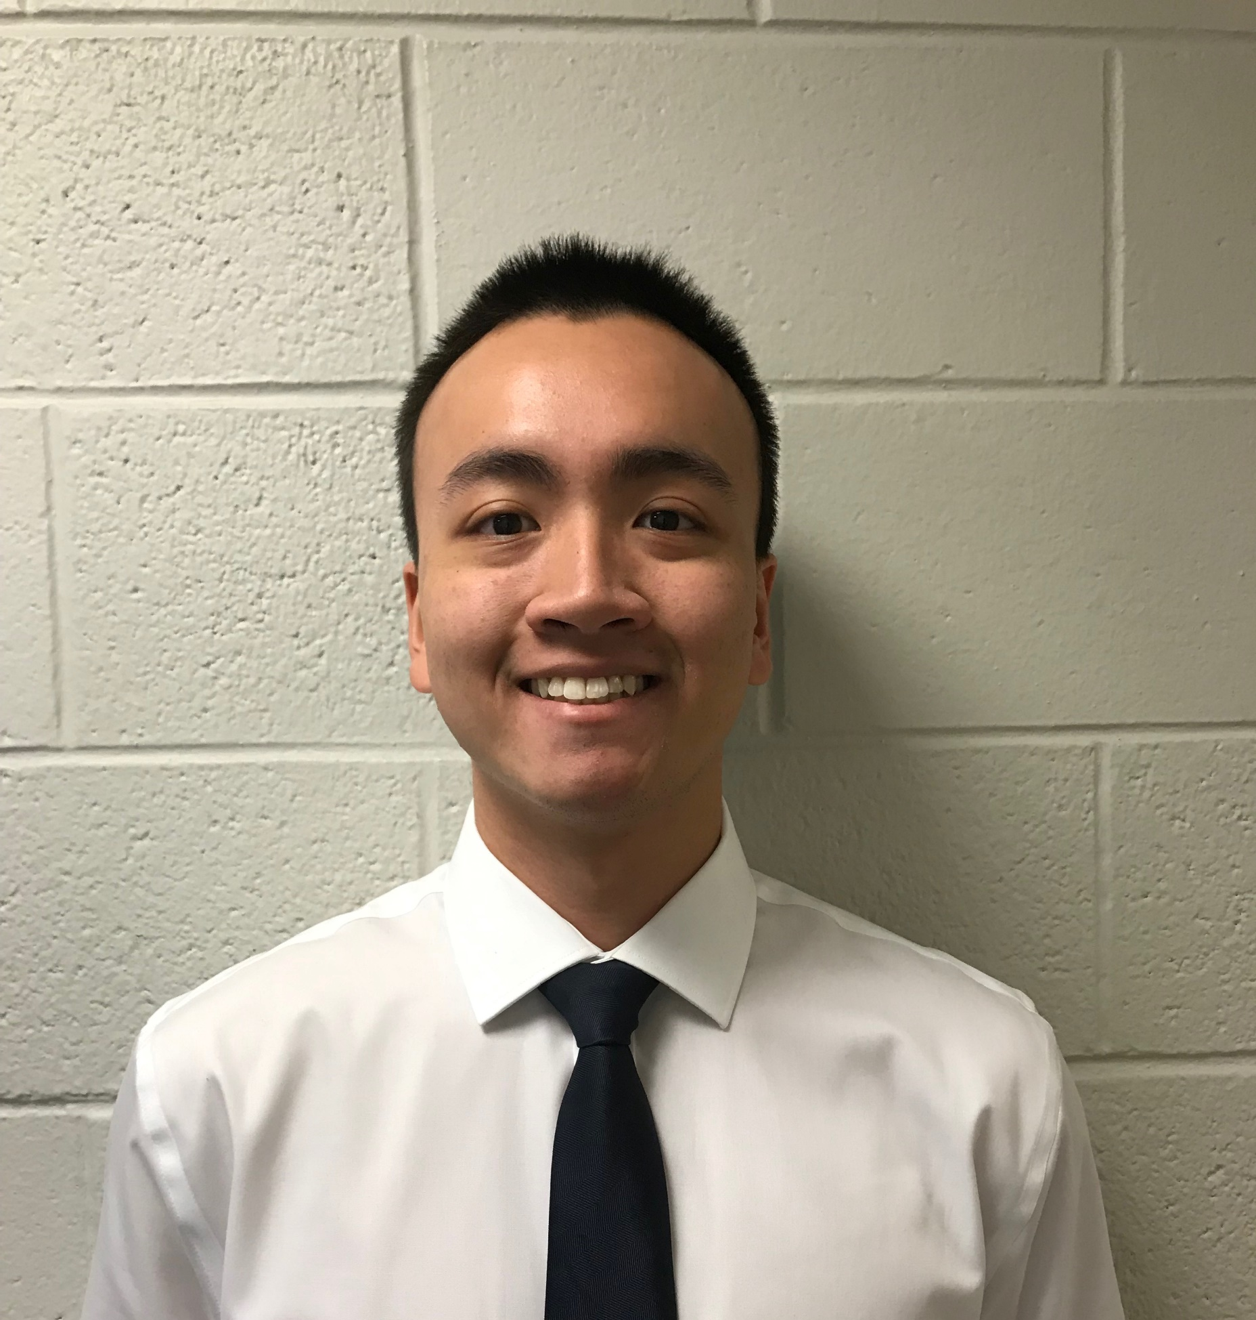




Team
Husam Shaik
CEO
Loi Pham
Ram Vadlamudi
Rupesh Gudipudi
CFO
CTO
RND
PAX

Slide 13

Summary
Removes barriers mental health care, Allowing patients to live healthier lives
Help researchers to study mental disorders more efficiently
A new step to better mental health

Slide 14
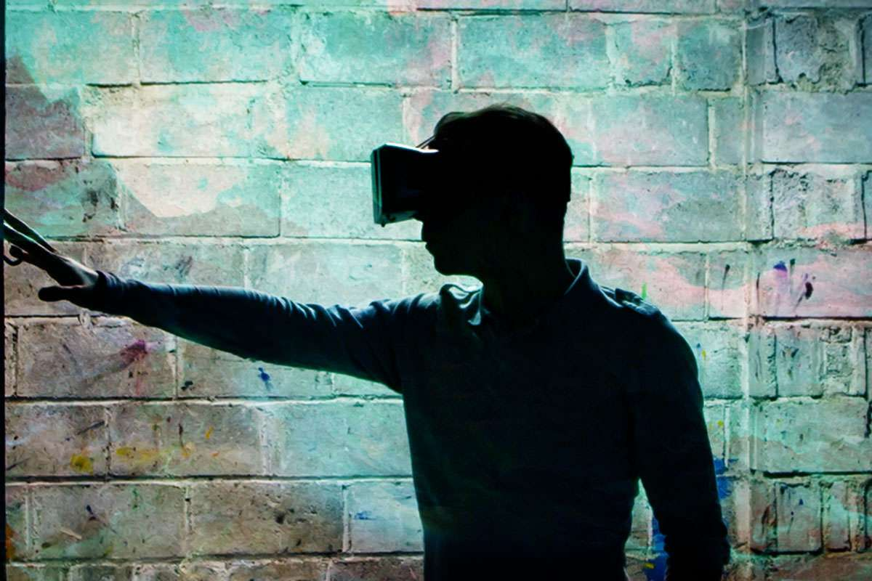




Thank You
PAX
Husam Shaik
+1 (704) 756-3130
hshaik@live.unc.edu

